Slide 1
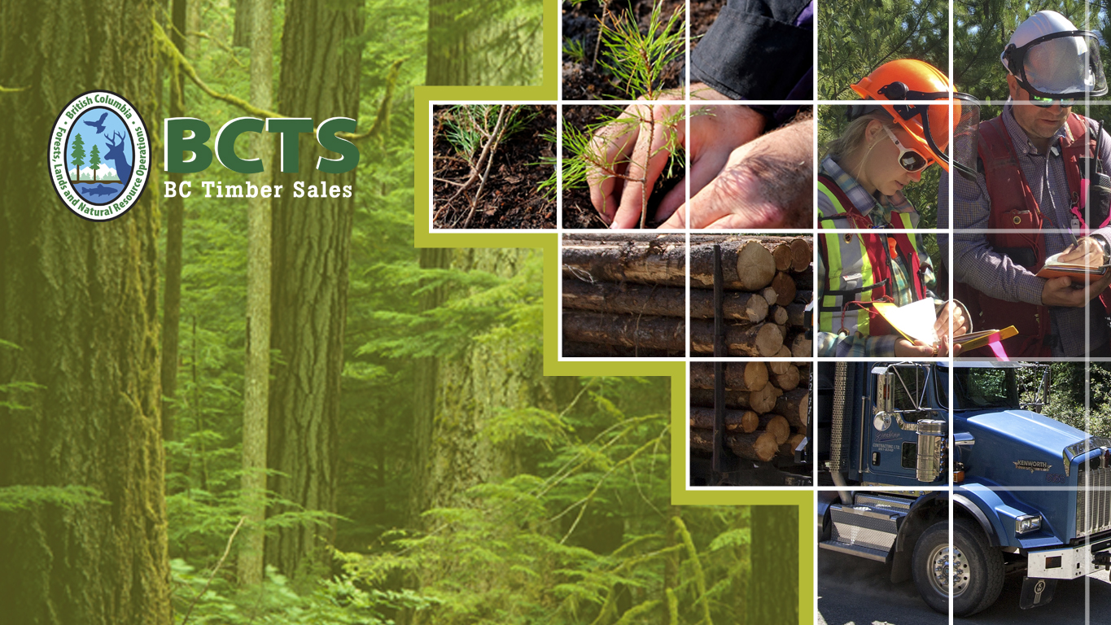
Op Area Selection Process

Slide 2

Background
BCTS is a self-supporting program within FLNRORD.
BCTS is a Crown agency; it is a licensor and is never a licensee.

Slide 3
Background
Goal: To provide credible representative price and cost benchmark data for the market pricing system (MPS) through auctions of public timber.
Relevant Objectives:
  Sell the full BCTS apportionment over the business cycle, consistent with safe practices, sustainable forest management and reconciliation with Indigenous peoples.
  Generate net direct revenue and indirect provincial government revenue over the business cycle.

Slide 4
Background
For the purposes of Forest Act s. 81.1 (which is enabled by the CP/RP Regulation) ensuring BCTS generates representative MPS cost and price data from it’s operating areas is a government objective.
BCTS Babine requires updated operating areas as they are no longer representative of the THLB (primarily for Marginal Sawlog in the Bulkley)

Slide 5
Background
Historically non legal ‘chart area’ or ‘operating area’ agreements (OAA’s), characterized as ‘gentlemen’s agreements’ have guided licensee and BCTS development within TSA’s.
  OAA’s are not legal documents under forestry legislation.
  These is no basis in legislation for BCTS to co-sign an OAA.
  BCTS has no authority to lead or be a participant in a joint process with licenses

Slide 6
Background
BCTS will address its mandate through the fair and equitable re-distribution of the TSA timber profile, using the BCTS Selection Process.

Slide 7
Overview of Process
Notification of process.
Hiring a 3rd party (contractor) to prepare the data and conduct the analysis.
Establish base data set and current merchantable mature (CMM) definition.
  BCTS and licensees respectively to have 2 years of WIP/ADV and cutting permit volume removed
  Remove hard constraints (Parks, CORE’s etc)
  Maintain planning cells within existing operating areas
  Select cells that are appropriate operationally
  Determine cells of high importance to licensees, i.e. core areas in proximity to camps, etc

Slide 8
Overview of Process
Determine TSA CMM and share proportionally based on apportionment and partitions.
Select planning cells to achieve targets.
Summarize results.
First Nations consultation, Licencee review and comment.
CP/RP Regulation – Cabinet Approval.
Anticipated timeline ~ year to year and a half to complete.

Slide 9
Questions

